Slide 1



A Tale of a Flash Flood: WRF Modeling of Record Rainfall and Flooding in Arizona
Nathaniel J. Bochenek and Dr. Dorothea Ivanova
Department of Applied Aviation Sciences
Embry-Riddle Aeronautical University

Slide 2
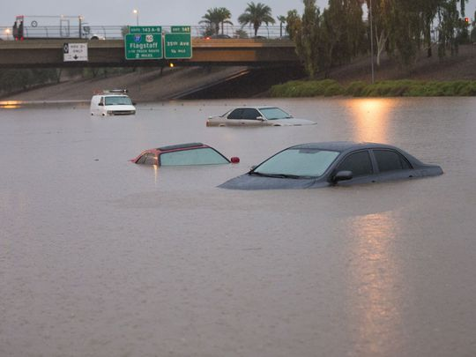
Motivation
Attempt to determine when a flashflood may occur:
  Power companies
  Prepare infrastructure
  Prevent loss of life
Hits close to home: PHX, Chandler, Tucson
Flooding resulted in:
  2 deaths
  200 destroyed homes
  Total property damage in excess of $100 million
Records broken:
  Most rainfall in single day in PHX
  2nd wettest PHX September in AZ history
Cars were stuck in flood waters on Interstate 10 east at 43rd Ave. after monsoon rains flooded the freeway in Phoenix Sept. 8, 2014. (Photo: Michael Chow/The Republic)

Slide 3
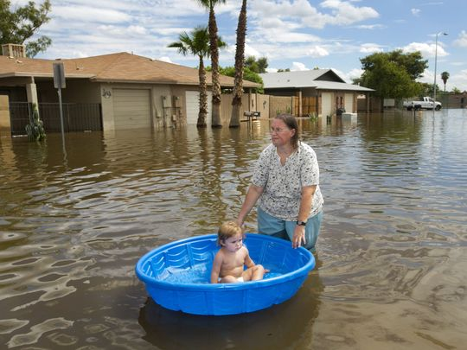
Research Objectives
To more accurately predict major moisture surges and flooding events in AZ using:
  Weather Research Forecasting Model (WRF)
  Sea Surface Temperature (SST)
  Tropical Cyclone Development
  Thunderstorm Development in Northwestern Mexico Monsoonal flow
  Low pressure locations
Simulate the Boundary Layer in AZ Prior and during the flash flood of 2014
  Vorticity
  U/V Components of the Wind
  MR
  Potential Temperature
  CAPE/CIN
Laura Moravek carries her granddaughter, Alyssa Guarino, in a pool as they walk through the flooded road of South Allen, just east of Stapley Drive in Mesa on Tuesday, September 9, 2014. (Photo: David Wallace/The Republic)

Slide 4
WRF setup 6 Sep - 9 Sep, 2014
The Advanced Research Weather Research and Forecasting mesoscale model (ARW-WRF), version 4.0.1, was implemented for a case study of 8th September 2014
Second nest centered over Central AZ, third nest centered over Chandler, AZ, 10 km grid resolution.
Outer domain centered over southwestern U.S. with a 30km grid resolution includes a large region of the southwestern U.S. extending offshore Baja-California
A Rapid Update Cycle (RUC) land-surface model was used for topographical features
Data assimilation and two-way nesting procedures were executed
Features of the boundary layer thermodynamic profiles, such as wind or hydrometeors, Convective Available Potential Energy (CAPE), and circulation were simulated and compared with satellite, radar, radiosonde and other forecast products
A convective parameterization was used with specification of entrainment and comprehensive microphysics.

Slide 5
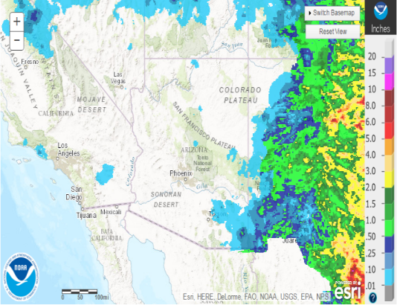
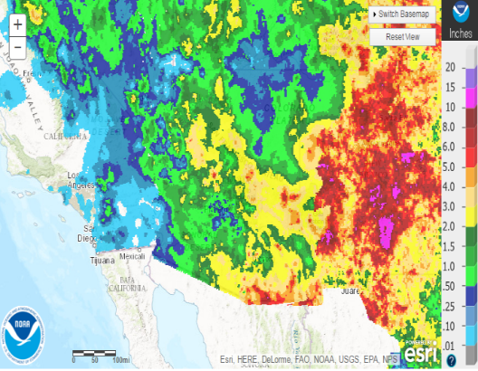
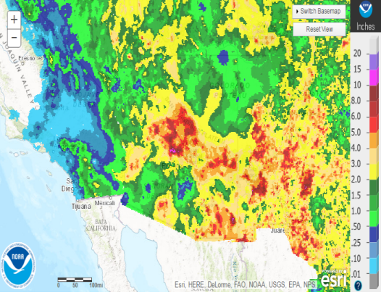
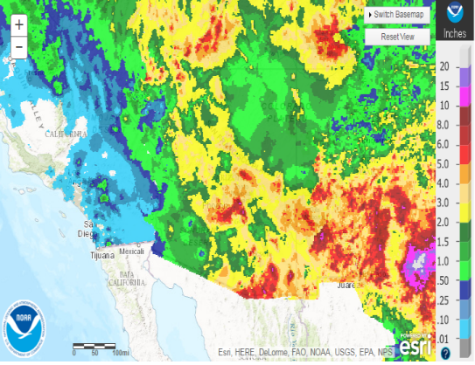
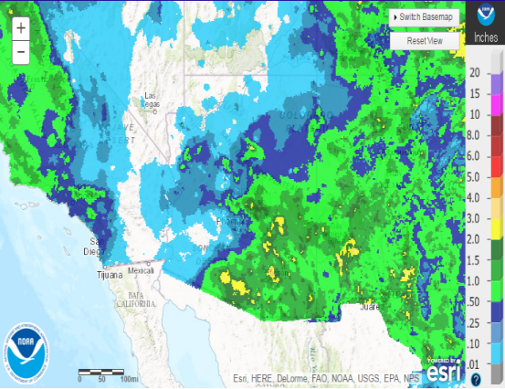
2014 Monsoon Season
15 June 2014 – 30 Oct 2014
Cumulative rainfall of 6.34 inches in AZ
  Avg monsoon rainfall is 2.71 inches
Wettest September since 1939
Influenced by moisture surge
June
July
Aug
Sep
Oct
Monthly observed precipitation accumulation images taken from the NWS Advanced Hydrologic Prediction Service.

Slide 6
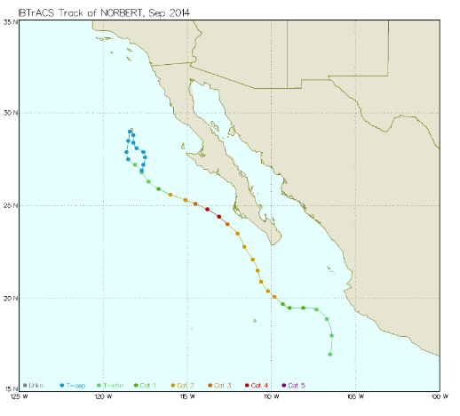
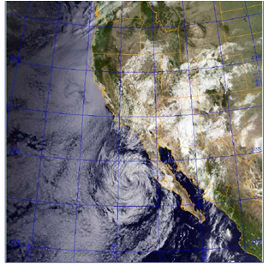
Tropical Cyclone: Hurricane Norbert
Track of Hurricane Norbert along with their categories, Sep 2014. Dissipated near northern Baja California and moist remnant rain bands propagated into SW AZ.
Visible / IR composite satellite photo of the western US, courtesy of the Naval Research Laboratory. Taken at 8:30 am MST on 9/8/2014.

Slide 7
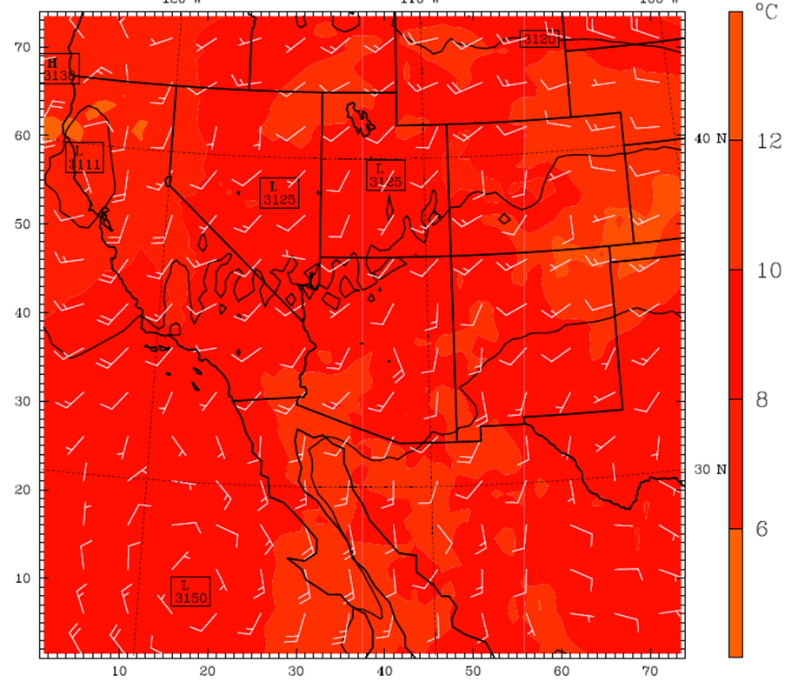
Moisture Surges
Minor surge:
  Moist southerly flow pushes into Arizona
  Enhances potential for convection
  Enhances thunderstorm potential
  Results in flooding
Major Surge
  Needs additional trigger (usually tropical cyclone)
  E Pacific trop cyclone enhances SSW flow from Gulf
  Causes more wind convergence is desert SW
WRF model output of temperatures, 700mb height contours, and wind barbs for 1800Z 8 Sep. Warm moist air propagated to the north feeding storms.

Slide 8
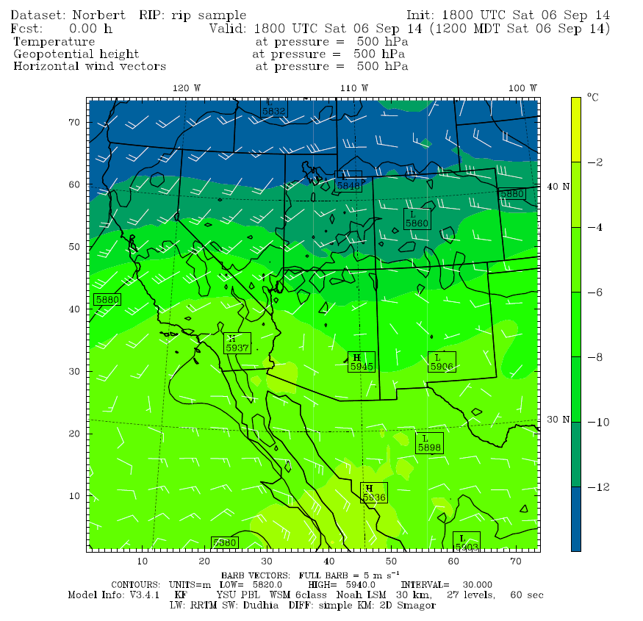
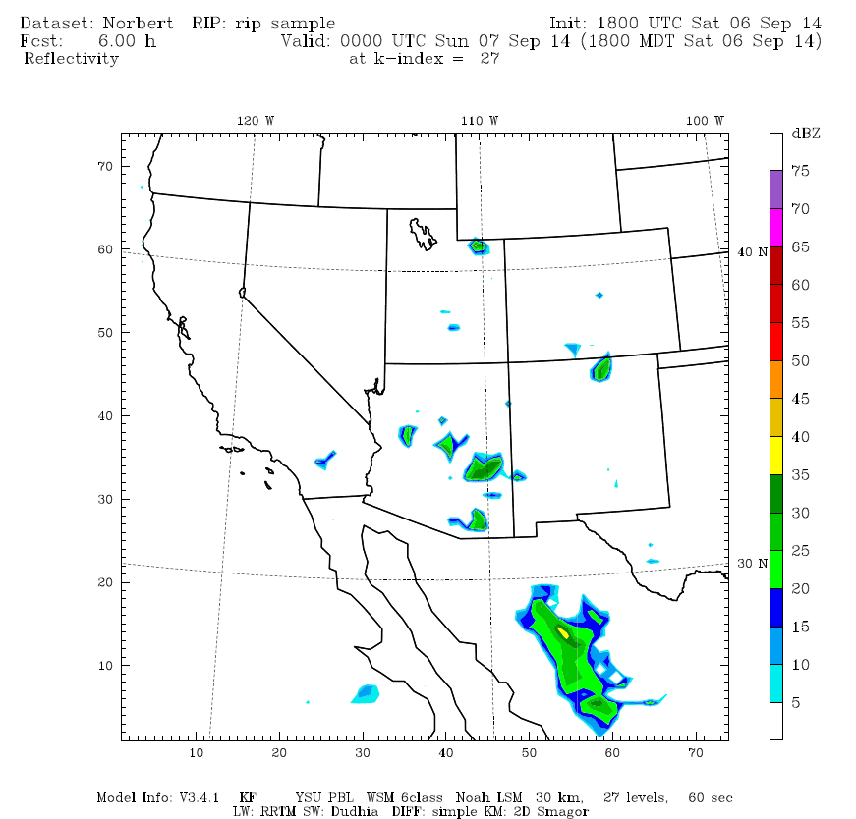
Major Surge Requirements
Low pressure over AZ
TS activity over NW Mexico
Precipitation cools air
Very warm SSTs –
Contributes to
instability
Counter- rotating pressure systems
Severe trigger
(Hurricane Norbert)
500 mb WRF output of low pressure systems over N Utah and Wyoming indicating CCW circulation pattern 1800Z 6 Sep
WRF radar output showing some convection and storm formation/precipitation over Sierra Madres 0000Z 7 Sep

Slide 9
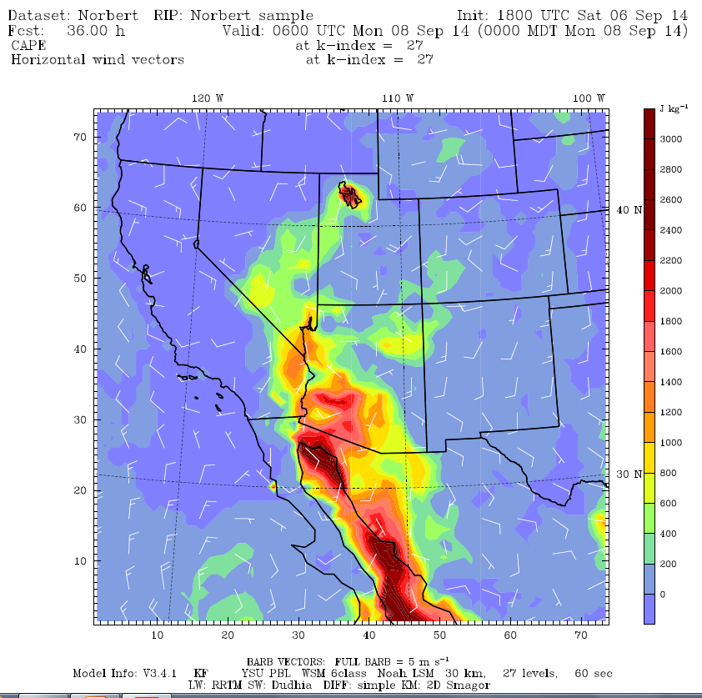
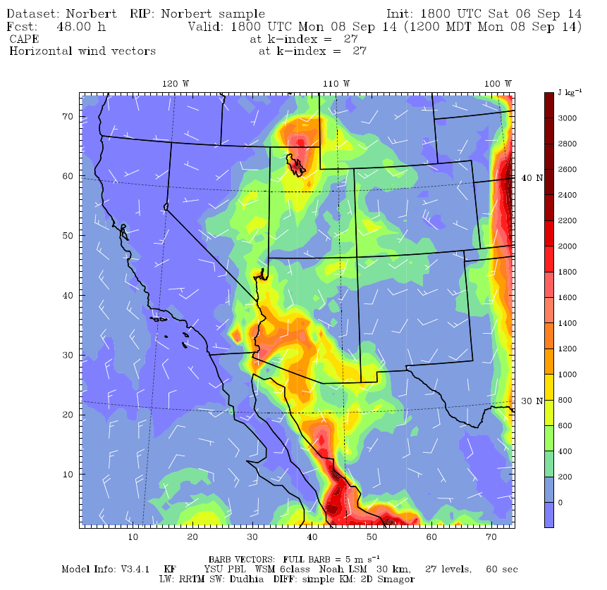
CAPE
WRF output for CAPE values over NW Mexico and AZ at 0600Z on 8 Sep. Moderate CAPE values are still seen over Sierra Madres.
WRF output for CAPE values over NW Mexico and AZ at 1800Z on 8 Sep at the time of the flooding. CAPE propagated NNE and encompassed Tucson.

Slide 10
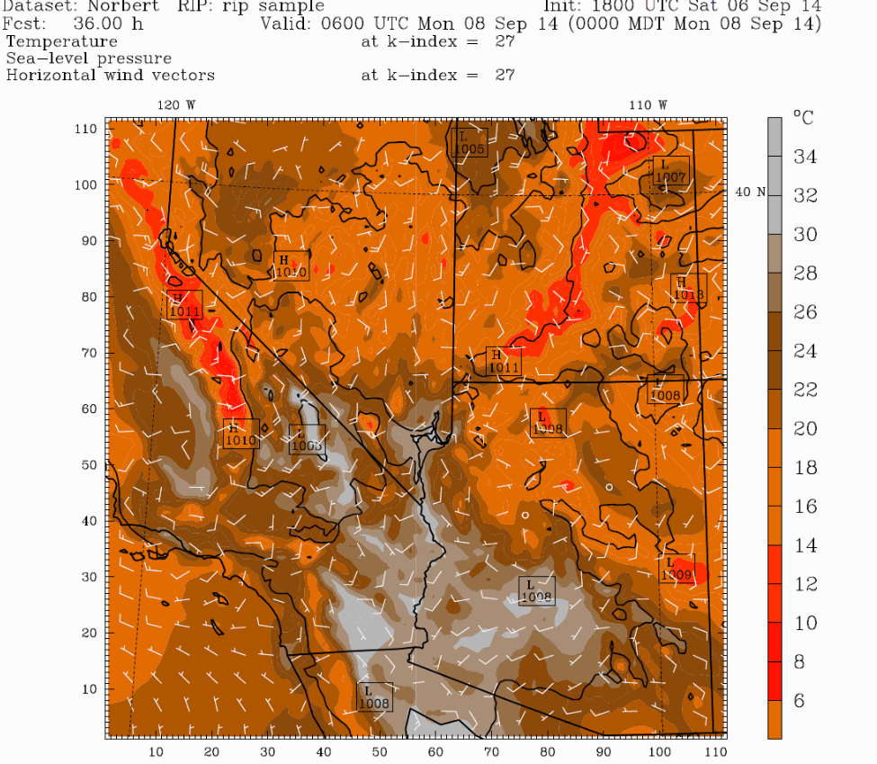
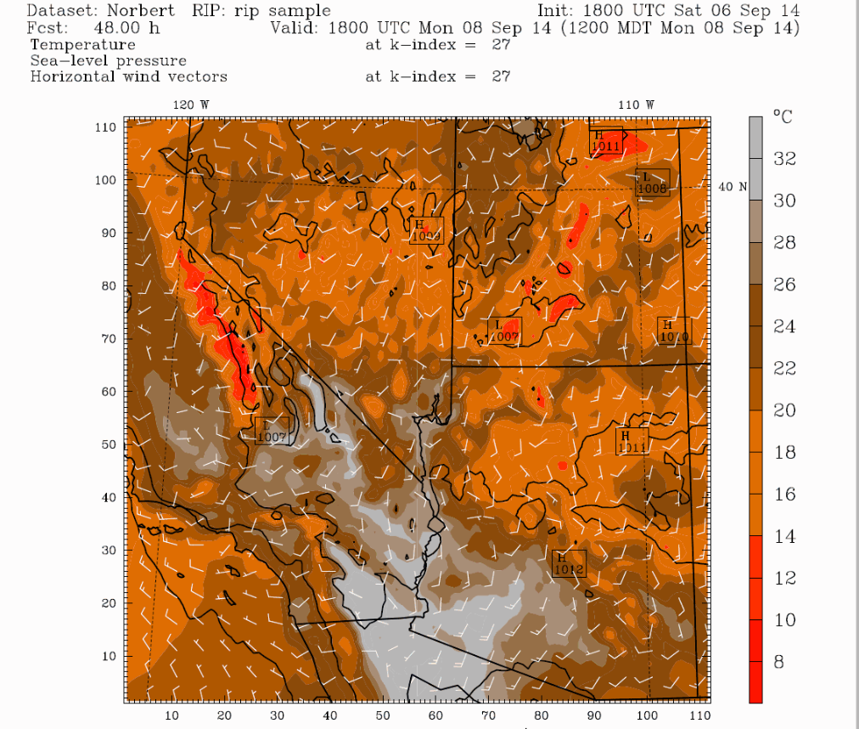
Increased SLP
WRF model output for MSL pressure, surface temperatures (in degrees Celsius), and surface winds (kts) at 06Z on the 8th.
WRF model output for MSL pressure, surface temperatures (in degrees Celsius), and surface winds (kts) at 18Z on the 8th.

Slide 11
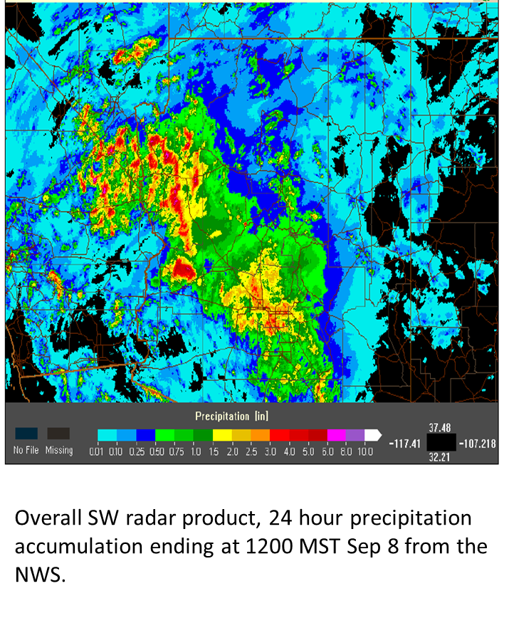
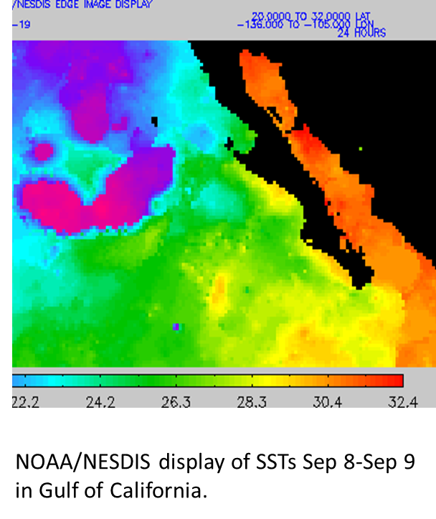
Warm SSTs and Moisture Propagation

Slide 12
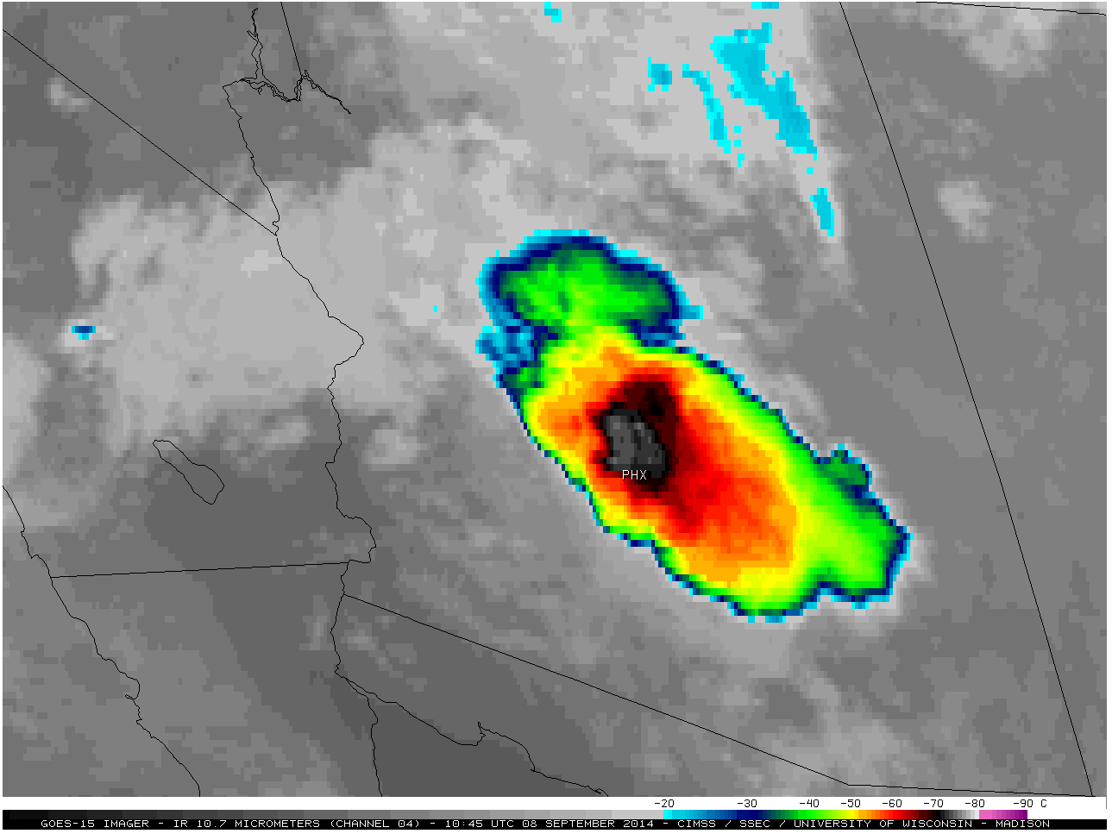
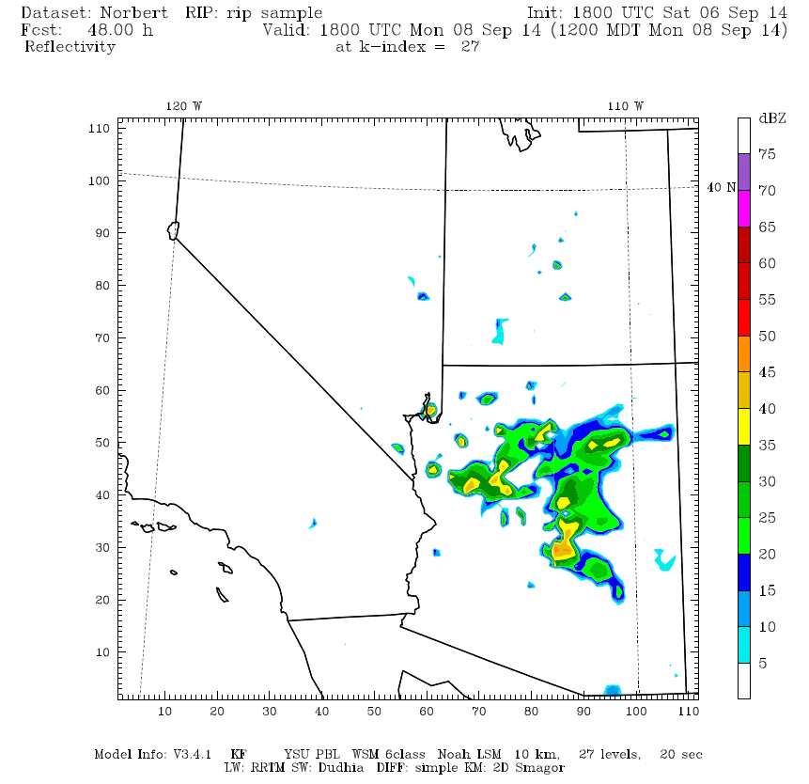
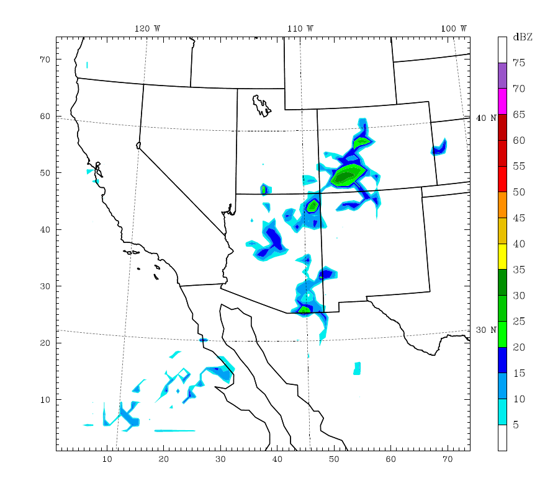
Verification of Precipitation intensity
Enhanced Infrared Satellite image from 1045 UTC 08Sep14 from University of Wisconsin.
What the WRF predicted for radar reflectivity at 1100 MST on Sep 8.
WRF output predicted rain would propagate over Tucson as well on 1200Z on 9 Sep.

Slide 13
Conclusions:
• Model validations with satellite and radar products demonstrate skill of the WRF model in predicting the CAPE, precipitable water, wind and total precipitation field conditions during September 2014 flash flood significant event
• WRF model run results did a good job at reflecting the actual events that occurred on September 8th, 2014. As model resolution is refined, the model remains stable, and most variables are in agreement with observations
• A presence of a major surge event in the Gulf of Baja-California during the simulations period was detected and monitored by the group of Dr. Miguel Lavin from CISSESE –Ensenada, Mexico’s Oceanographic Institute.

Slide 14
Acknowledgements
Thank you to Dr. Ivanova for being my research advisor, mentor and meteorology professor.
Thank you to the NASA Space Grant program at Embry-Riddle for funding this research opportunity.

Slide 15
References
(2014, September 10). Retrieved January 29, 2019, from https://www.climate.gov/news-features/event-tracker/record-breaking-rain-arizona
Analysis of 2002 and 2003 Warm-Season Precipitation from the North American Monsoon Experiment Event Rain Gauge Network. (n.d.). Retrieved January 29, 2019, from https://journals.ametsoc.org/doi/abs/10.1175/MWR2838.1
Avila, L. A. (2014). Hurricane Norbert (Rep. No. EP142014). NOAA/NWS.
Fritz, A. (2014, September 08). Phoenix sees wettest day on record, widespread flooding shuts down interstates. Retrieved January 29, 2019, from https://www.washingtonpost.com/news/capital-weather-gang/wp/2014/09/08/phoenix-sees-wettest-day-on-record-widespread-flooding-shuts-down-interstates/?noredirect=on&utm_term=.5f608fb0d6f1
Multiscale Variability of the Flow during the North American Monsoon Experiment. (n.d.). Retrieved January 29, 2019, from https://journals.ametsoc.org/doi/abs/10.1175/JCLI4087.1
Preliminary Diagnostics from a New Event-Based Precipitation Monitoring System in Support of the North American Monsoon Experiment. (n.d.). Retrieved January 29, 2019, from https://journals.ametsoc.org/doi/abs/10.1175/1525-7541(2003)0042.0.CO;2
Synthesis of Results from the North American Monsoon Experiment (NAME) Process Study. (n.d.). Retrieved January 29, 2019, from https://journals.ametsoc.org/doi/abs/10.1175/JCLI4081.1
The Impact of Ice Phase Cloud Parameterizations on Tropical Cyclone Prediction. (n.d.). Retrieved January 29, 2019, from https://journals.ametsoc.org/doi/abs/10.1175/MWR-D-13-00058.1

Slide 16
Questions?

